Slide 1

Manufacturing Analysis(P639)

Slide 2

Team(group1)
Sakshi Gorivale
Umang Patel
Nidhi Gupta
Shubham Pawar
Vinay Chaudhari
Aditya Jaiswal

Slide 3

Short Insight
In our Manufacturing analysis, we focused on key metrics such as production quantity, rejection rates, and operational efficiency across tools like Excel, Tableau, Power BI, and SQL. Each platform was used to highlight different aspects, from machine performance to employee productivity and department-level analysis.
We developed KPIs that tracked production output, identified areas of high rejection, and compared performance across work centers. These insights were combined into an interactive dashboard, providing a comprehensive view of the manufacturing process.

Slide 4






Key Performance Indicator's
Manufactured
Quantity
Rejected Quantity
Processed
Quantity
Wastage
Percentage
Produced
Quantity
Total
Employees
86.8M
total number of
units that were successfully manufactured
525K
total number of units that were rejected during the production process
0.60%
proportion of the total produced quantity that was rejected
129
work force required for production process
86.2M
total quantity of items that have gone through the entire production process
125M
total number of units successfully produced and accepted after considering the rejected quantities

Slide 5
Key Performance Indicator's
Employee wise Rejected Quantity
Shruti Singh accounts for 99.60% of the total rejected quantity, which is a critical issue to address.
This stark disparity suggests either a training need, equipment malfunction, or other process inefficiencies associated with this employee's work.
The other employees have relatively low rejection rates, indicating acceptable performance.

Slide 6
Key Performance Indicator's
Machine wise Rejected Quantity
Machine C007 has the highest rejection rate at 15.27%, indicating that this machine is a major contributor to production waste.
Investigating the cause whether due to machine failure, incorrect settings, or operator error will help to reduce these rejection rates.
Other machines also contribute to rejections but at a lower level, which could also benefit from regular maintenance and operational checks.

Slide 7
Key Performance Indicator's
Production Comparison Trend
This line chart that tracks the monthly Produced Quantity and Rejected Quantity throughout the year. Both the lines showing fluctuations.
November is production peak indicates period of higher manufacturing activities but also had faced quality control challenges. Significant drop at December shows reduction in production or reduce demands.
High production volumes correlate with higher rejection rates indicating that when the production increases , quality issues may arise.

Slide 8
Key Performance Indicator's
Manufactured VS Rejected Quantity
The total rejected quantity (525K) is small compared to the manufactured quantity (87M), suggesting that the production process is mostly efficient. However, continuous improvement should focus on reducing this rejected figure further to enhance productivity and reduce costs.

Slide 9
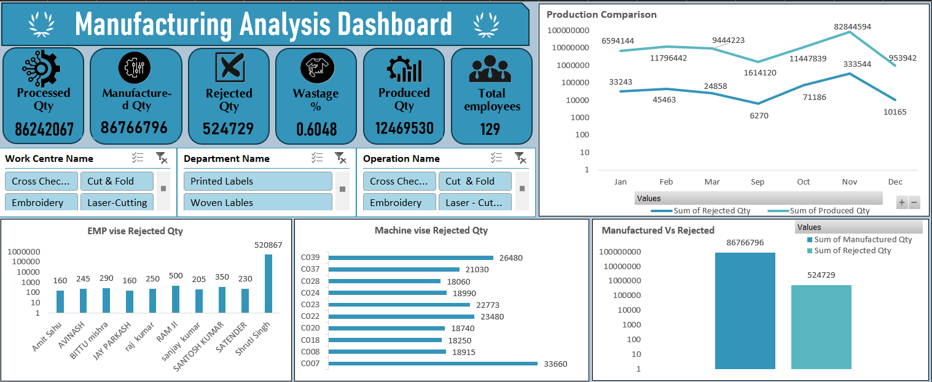
Excel

Slide 10
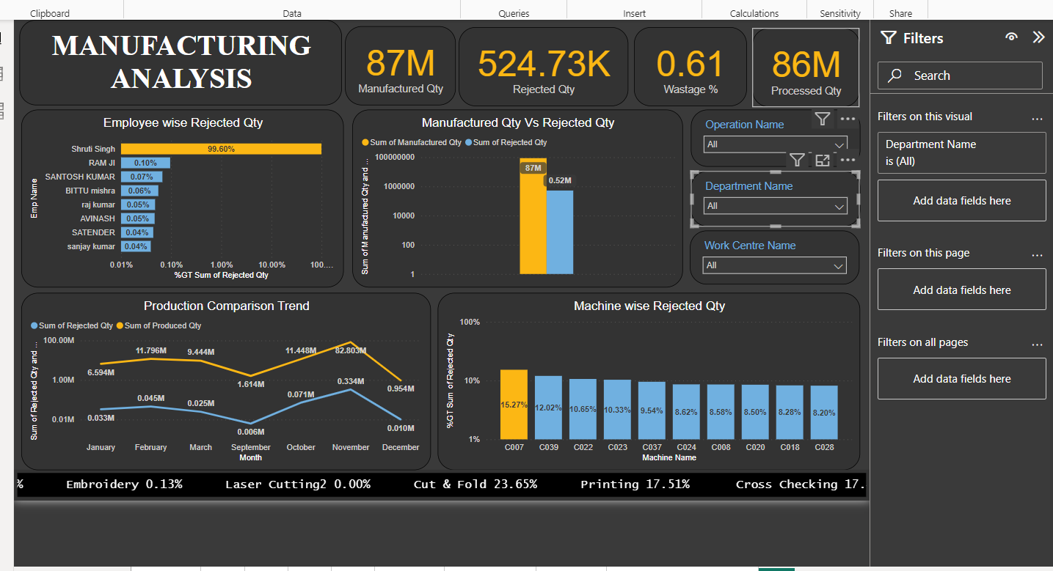
Power BI

Slide 11
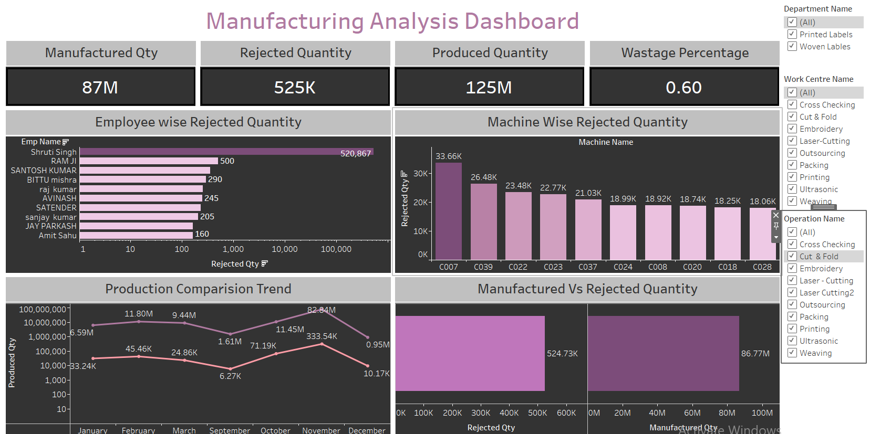
Tableau

Slide 12



SQL

Slide 13
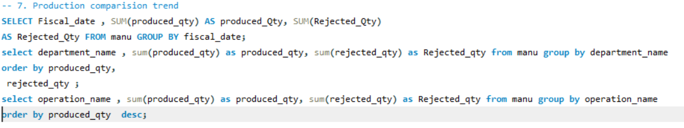


SQL

Slide 14

Conclusion
The textile manufacturing facility demonstrates strong production capabilities with over 86.8M units manufactured, but faces quality control challenges, especially during high-output months like November, where higher rejection rates were observed. Improving quality checks during peak production, addressing employee and machine performance discrepancies, and optimizing operations in months with lower production (September and December) can help reduce wastage and enhance overall efficiency. By focusing on these areas, the facility can increase both production and profitability while maintaining high standards of quality.

Slide 15


